Slide 1
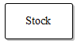


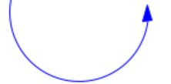

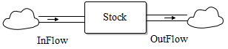
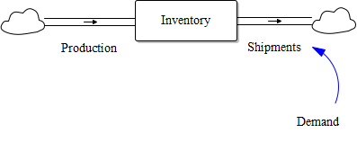
Stocks are represented by rectangles (suggesting a container holding the contents of the stock).
Clouds represent the sources and sinks for the flows. A source represents the stock from which a flow originating outside the boundary of the model arises; sinks represent the stocks into which flows leaving the model boundary drain. Sources and sinks are assumed to have infinite capacity and can never constrain the flows they support.
Flows are shown as lines with arrows. Inflows point into the stock (adding to it), while outflows point away from the stock (subtracting from it).
Relationships are shown as arrows connecting variables to flows, other variables, or from stocks to variables. They represent informational influence, not material flow. Only flows change stocks; variables influence flows and stocks can influence variables, but never the other way around.
Variables hold formulas, parameters, or constants that provide input for calculations. They influence flows or other variables, but do not store or move material.
Stock with Inflow and Outflow: A stock collects inflows and loses outflows, illustrating accumulation and depletion over time.
Inventory Example with Demand Influence: Production adds to inventory; shipments remove from inventory. The shipment flow is influenced by demand, demonstrating how variables control flows based on system conditions.

